Slide 1


Machine Learning applications
PIERANGELA BRUNO
pierangela.bruno@unical.it

Slide 2
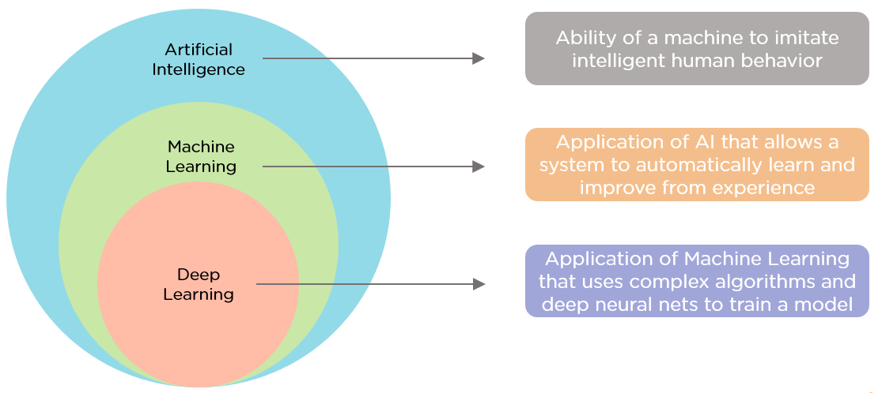

Data-driven AI
DEEP LEARNING
MACHINE LEARNING
DATA MINING
STATISTICS

Slide 3
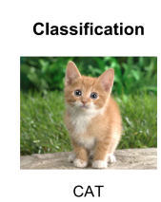
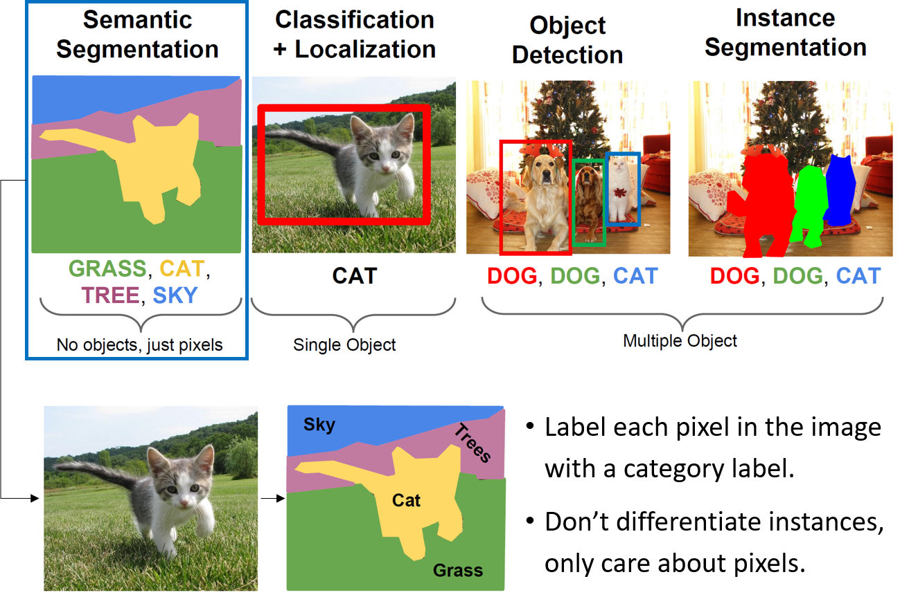
Computer Vision
In computer vision the main tasks are focus on making computers understand digital images as well as visual data from the real world by extracting, processing, and analyzing information from such inputs to make decisions.

Slide 4
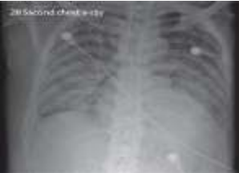
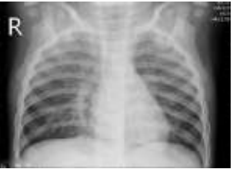
Classification
Classification refers to the task of labelling an input data into one of fixed predefined classes.
Examples of classification tasks:
Image classification
Medical Diagnosis
Sentiment Analysis
covid-19 disease
healthy patient
Bruno, P. et al. "Understanding Automatic Pneumonia Classification Using Chest X-Ray Images." AIxIA, 2020.
Notes:
*Sentiment Analysis: Determining whether a piece of text is positive, negative, or neutral.

Slide 5
Image segmentation
Recognize and understand what is in the image at pixel level.
In computer vision, semantic segmentation is the process of partitioning a digital image into multiple image regions and assigning a label to every pixel in an image such that pixels with the same label share certain characteristics.

Slide 6
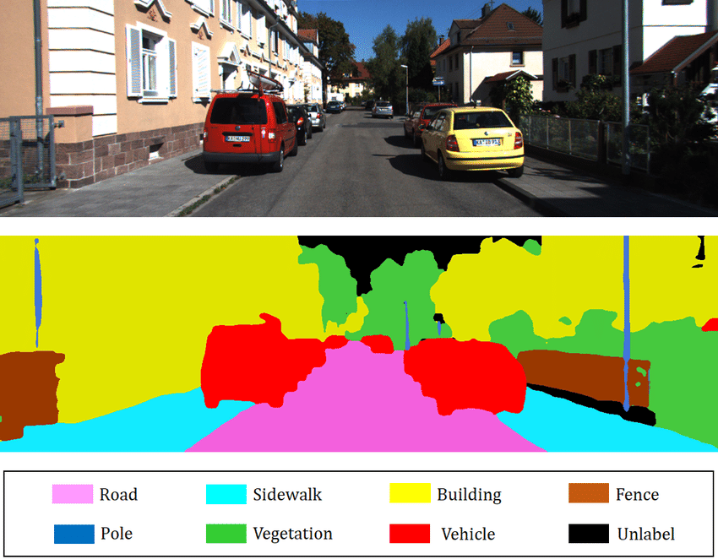
Semantic segmentation
Semantic segmentation can be applied in different domain, e.g.,:
• Medical Imaging
• Autonomous Driving
• Video Surveillance
• Robotics
image from: https://towardsai.net/p/l/machine-learning-7

Slide 7
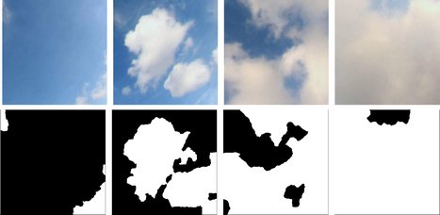
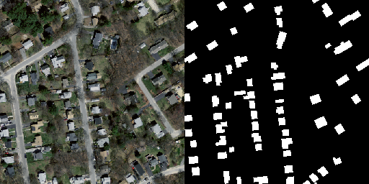
Binary segmentation
Classify the pixels of an image into two categories: pixels belonging to the objects of interest and pixels belonging to the background of the image.
images from: https://paperswithcode.com/dataset/swimseg, https://medium.com/the-modern-scientist/remote-sensing-datasets-for-artificial-intelligence-semantic-segmentation-1737ca1f35c1

Slide 8
Object detection
In computer vision, image detection is the process of detecting objects in an image.
Image classification predicts the class of one object in an image.
Object localization identifies the location of one or more objects in an image and drawing a bounding box around their extent.
Object detection combines these two tasks and localizes and classifies one or more objects in an image.

Slide 9
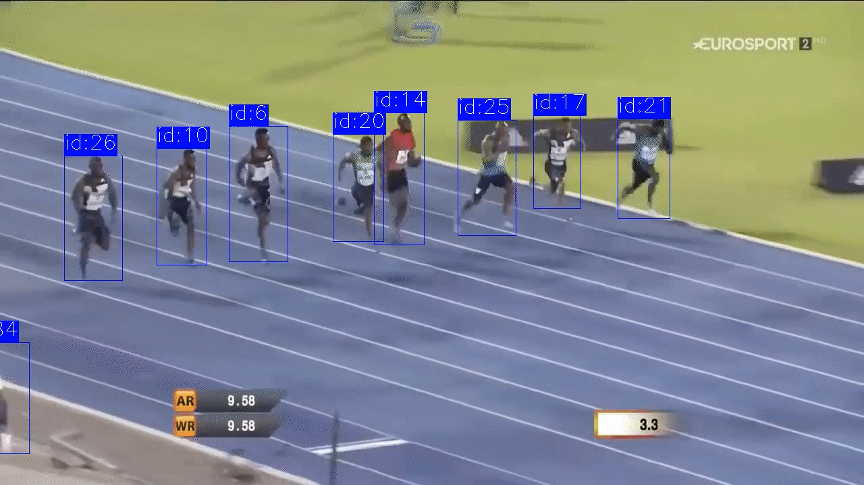

Object detection
Object detection can be used in different domains, e.g.,
Autonomous Driving
Sports Analysis
Face Detection
images from: https://medium.com/@pedroazevedo6/object-detection-state-of-the-art-2022-ad750e0f6003, https://learnopencv.com/understanding-multiple-object-tracking-using-deepsort/

Slide 10
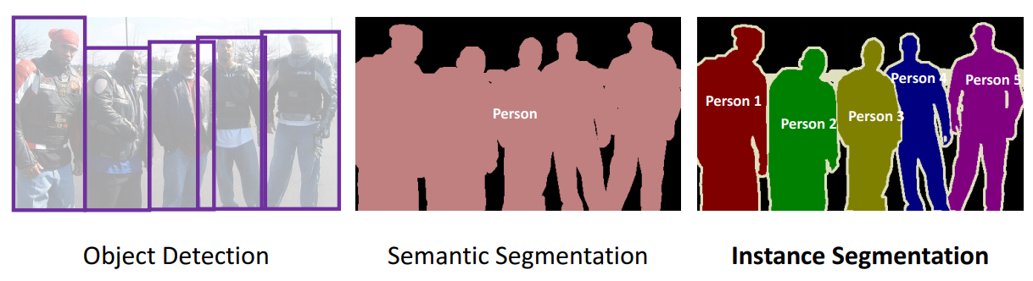
Instance Segmentation
In computer vision, instance segmentation is the process of detecting and segmenting each distinct object of interest appearing in an image.
Object detection + image segmentation
Instance Segmentation is useful when distinct objects of a similar type (class) are present and we need to monitor all of them separately.

Slide 11
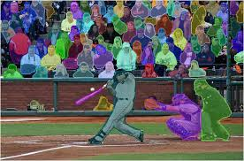
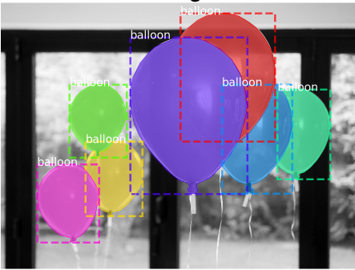
Instance Segmentation
images from: Li et al. “Fully Convolutional Instance-aware Semantic Segmentation”, https://aditi-mittal.medium.com/instance-segmentation-using-mask-r-cnn-7f77bdd46abd

Slide 12
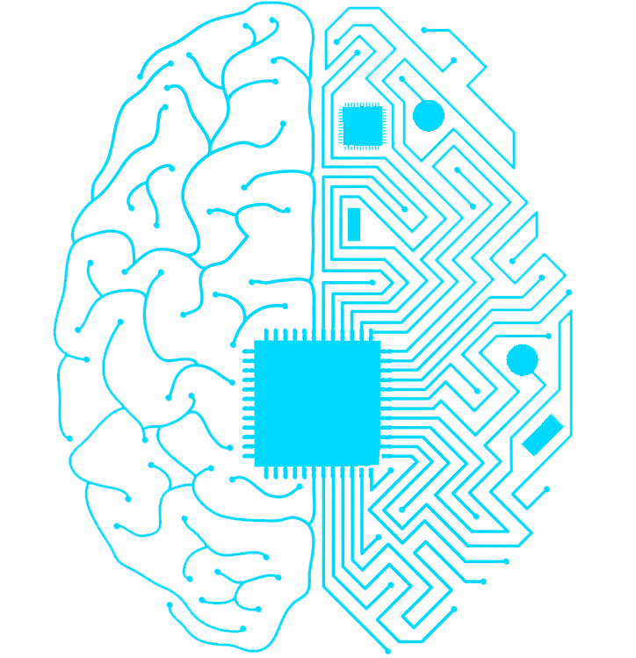
Learning a model

Slide 13

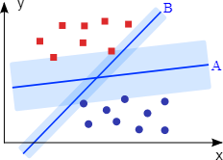
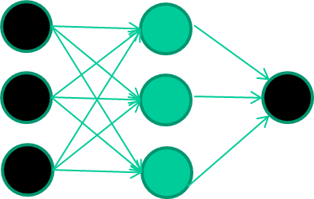
Leaning a model
Feature engineering and extraction
ML model
RAW DATA
OUTPUT
RAW DATA
OUTPUT
Deep Learning model

Slide 14
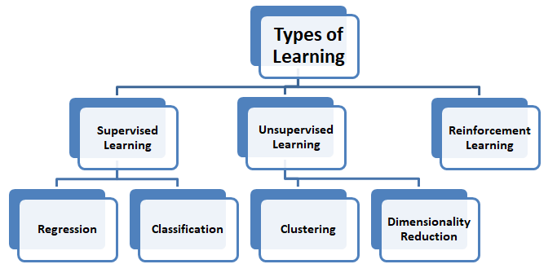
Types of learning
image from: https://www.c-sharpcorner.com/article/an-overview-of-supervised-unsupervised-and-reinforcement-learning-in-machine-l/

Slide 15
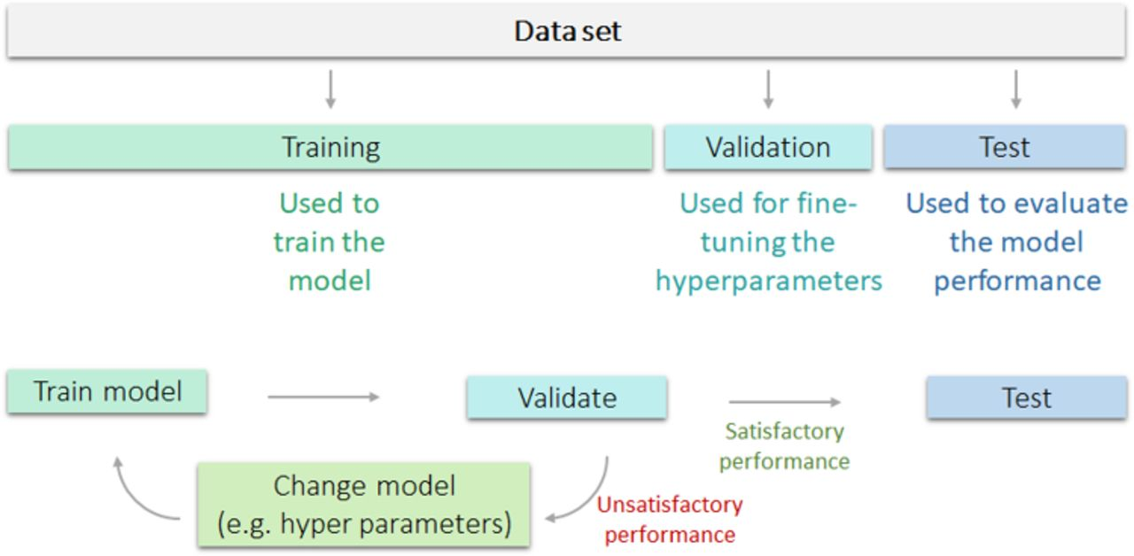
Learning a model: how to use the dataset

Slide 16
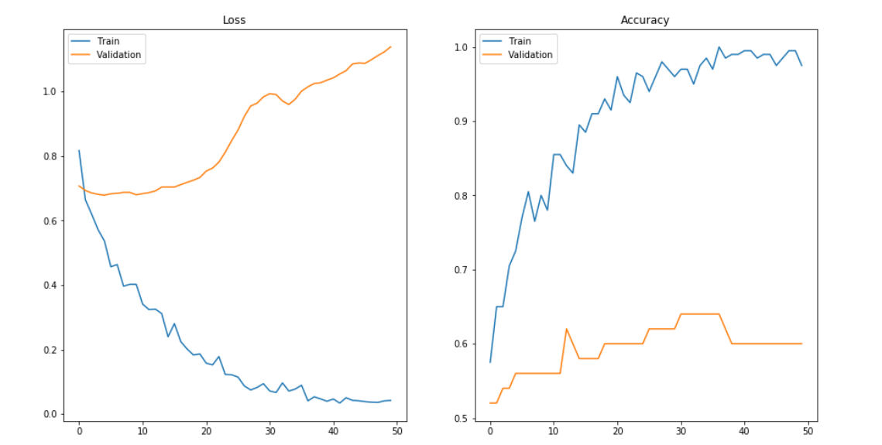
Learning: overfitting
Overfitting: model tries to fit the training data entirely and, at the end, memorize the data patterns, the noise and the features. These models fail to generalize and perform well in the case of unseen data (e.g., test set).
https://www.v7labs.com/blog/overfitting-vs-underfitting#:~:text=Overfitting%20is%20a%20common%20pitfall,scenarios%2C%20defeating%20the%20model's%20purpose.

Slide 17

Learning: overfitting
Overfitting happens when:
The training data is not cleaned. The model captures the noise in the training data and fails to generalize the model's learning.
The model has a high variance.
The training data size is insufficient, and the model trains on the limited training data for several epochs.
The architecture of the network is too complex and require a significant amount of time to train, and often lead to overfitting the training set.
Incorrect tuning of hyperparameters in the training phase leads to over-observing the training set, resulting in memorizing features.

Slide 18
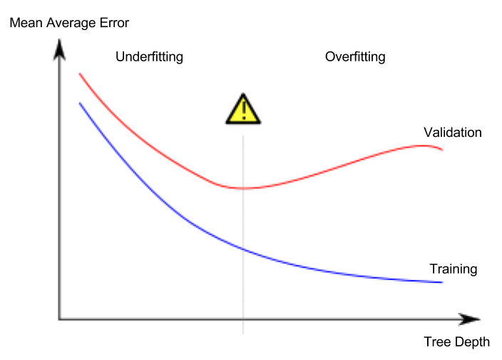
Learning: underfitting
The model cannot create a mapping between the input and the target variable. Under-observing the features leads to a higher error in the training and unseen data samples. It is detected when the training error is very high and the model is unable to learn from the training data.

Slide 19
Learning: underfitting
Underfitting happens when:
Unclean training data containing noise or outliers can be a reason for the model not being able to derive patterns from the dataset.
The model has a high bias due to the inability to capture the relationship between the input examples and the target values. This usually happens in the case of varied datasets.
The model is assumed to be too simple - for example, we train a linear model in complex scenarios.
Incorrect hyperparameters tuning often leads to underfitting due to under-observing of the features.

Slide 20
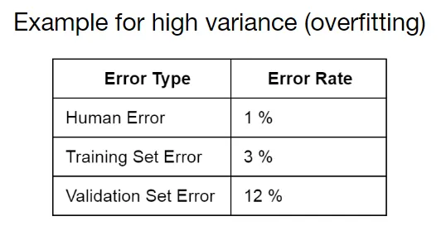
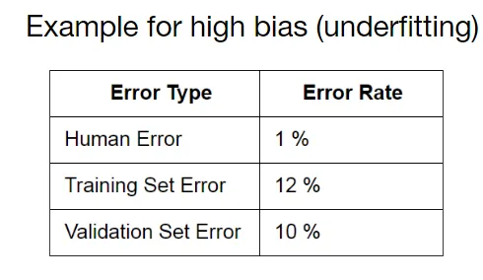
Identify Overfitting and Underfitting
Observe the performance of a model during training: compute the error rate for each epoch on the training set and a validation set.
Over time, as the algorithm learns properly, the error of the model on the training data and validation data will go down.
much worse w.r.t. training set
very bad performance on both data sets
Notes:
The performance of the model on the validation set is much worse than on the training set. A clear indicator of the fact the model overfits on the training set.

Slide 21
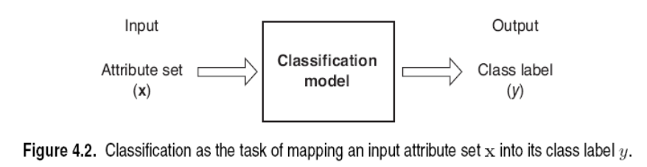
Classification
Classification is the task of learning a target function f that maps attribute set x to one of the predefined class labels y
Classification process:
Find examples for which you know the class (training set)
Find a set of features that discriminate between the examples within the class and outside the class
Create a model that given the features decides the class
Apply the model to new examples

Slide 22
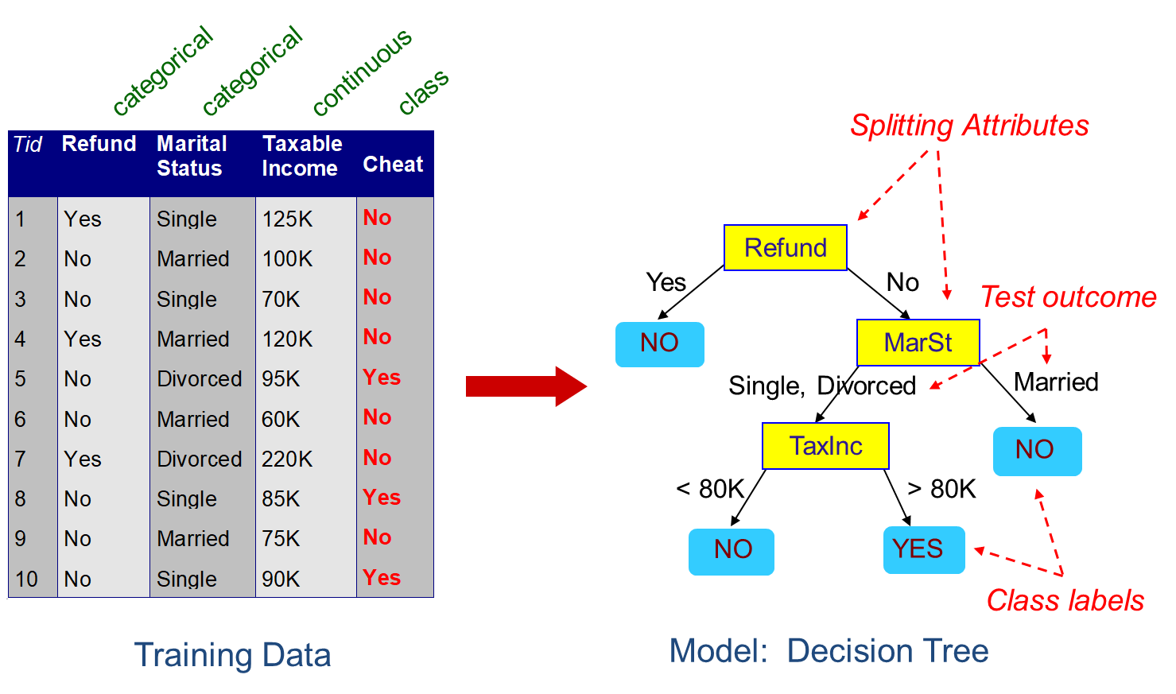
Decision Tree
A flow-chart-like tree structure
Internal node denotes a test on an attribute
Branch represents an outcome of the test
Leaf nodes represent class labels or class distribution

Slide 23
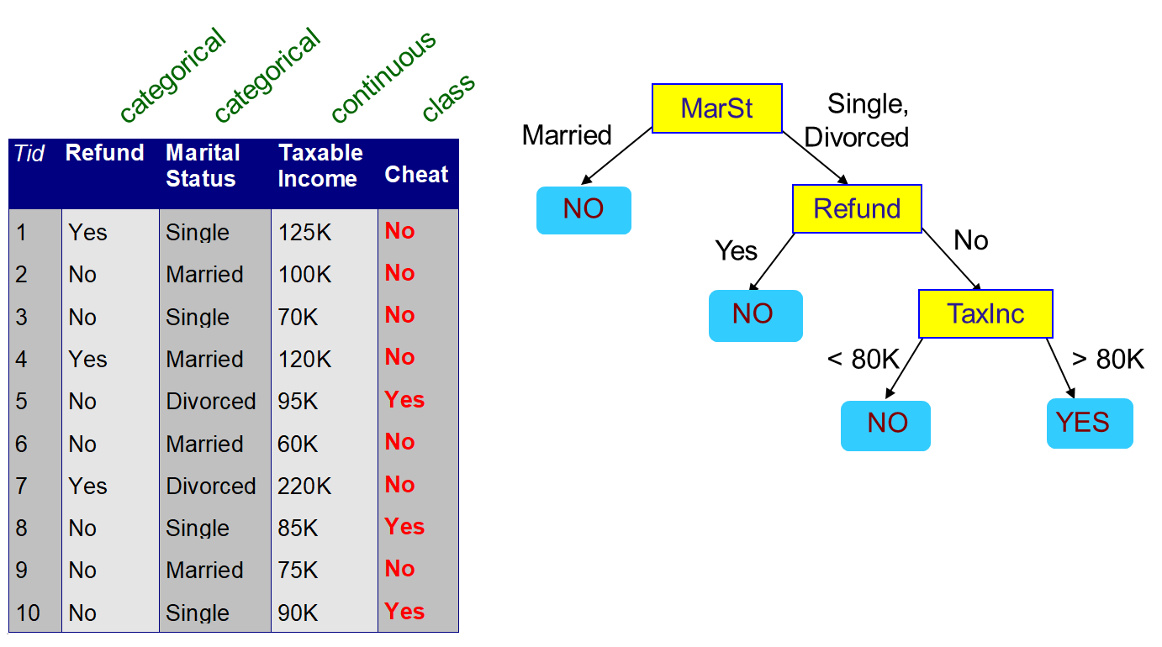
Decision Tree
There could be more than one tree that fits the same data!

Slide 24
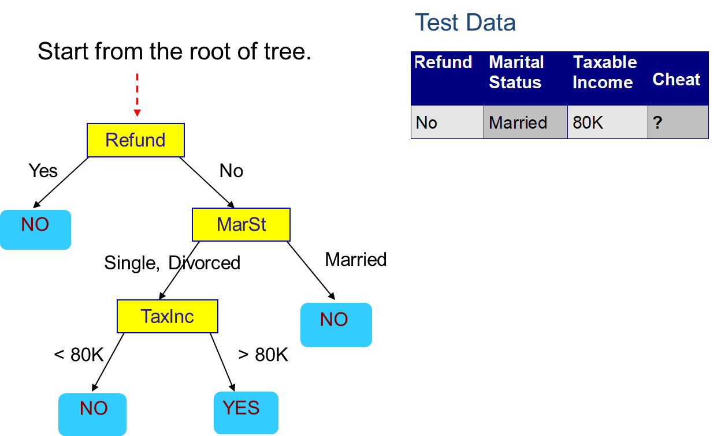
Decision Tree: apply model on test set

Slide 25

Decision Tree: apply model on test set

Slide 26
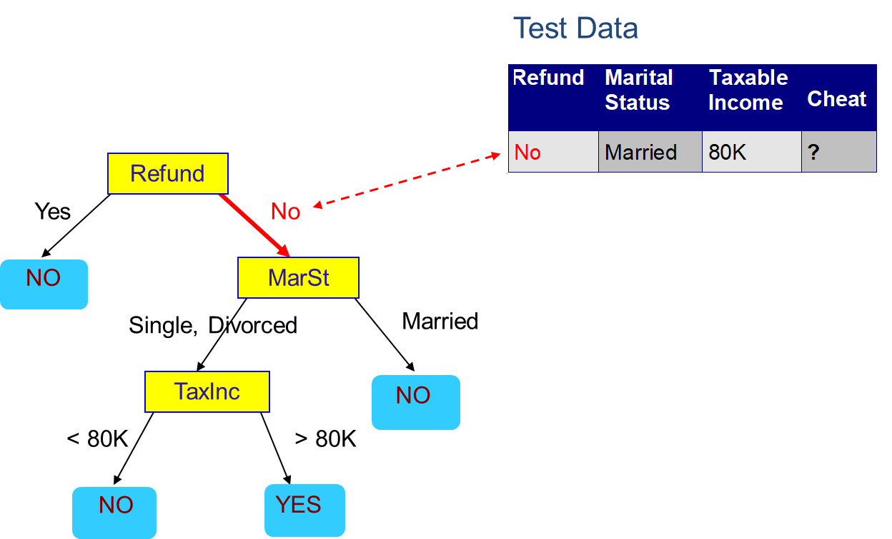
Decision Tree: apply model on test set

Slide 27

Decision Tree: apply model on test set

Slide 28

Decision Tree: apply model on test set

Slide 29
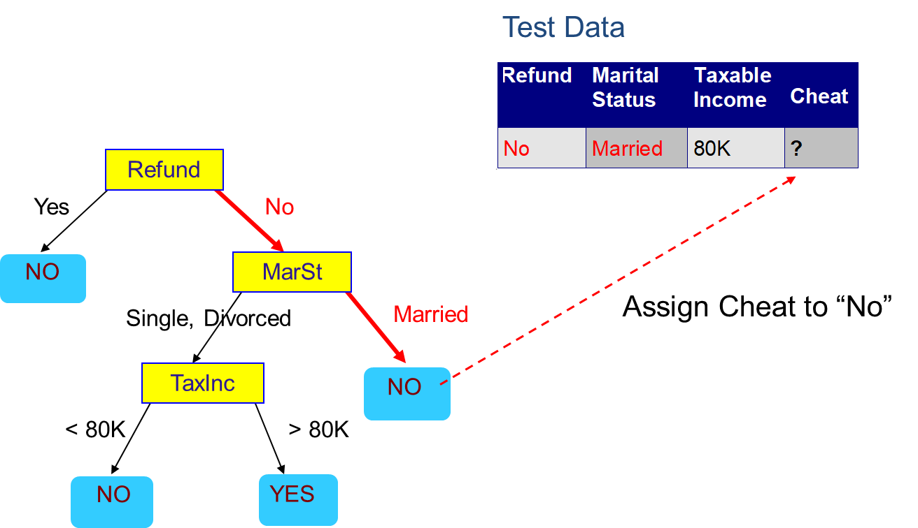
Decision Tree: apply model on test set

Slide 30
Decision Tree Induction
There are different decision tree algorithms:
ID3
C4.5 (a successor of ID3)
CART
ID3, C4.5 and CART follow a top-down approach, which starts with a training set of tuples and their associated class labels
The training set is recursively partitioned into smaller subsets as the tree is being built

Slide 31
Attribute Selection Method
Attribute Selection Method is a procedure to select the attribute that ‘best’ discriminates the given tuples according to class
It use an attribute selection measure
Popular measures are:
Information Gain, Gain Ratio and, Gini Index
The attribute selection measure provides a score for each attribute
The attribute having the best score for the measure is chosen as the splitting attribute for the given tuples

Slide 32
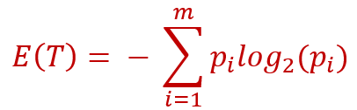
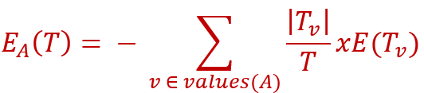
Information Gain
Let T be a training set and A be an attribute on which we want to partition the tuples in T
Information Gain measures the quality of a split
It is defined as the difference between the expected information needed to classify a tuple in T and the expected information required to classify a tuple from T based on the partitioning by A
Gain(A) = E(T) − EA(T)
entropy of T after the split on A
entropy of T before the split
The attribute A with the highest information gain is chosen as the splitting attribute
Entropy measures the uncertainty/ randomness in the data

Slide 33
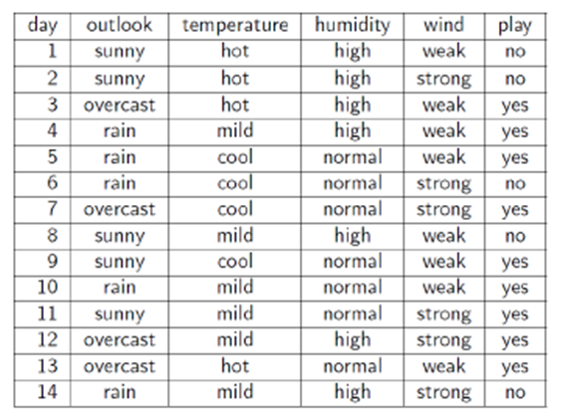
Information Gain Example
IG (windy) = 0.048 IG (outlook) = 0.246 MAXIMUM IG
IG (humidity) = 0.151
IG (temperature) = 0.029

Slide 34
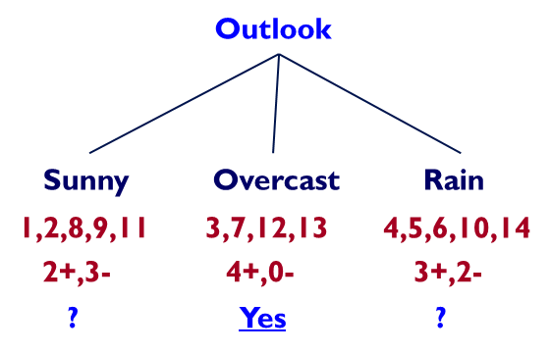

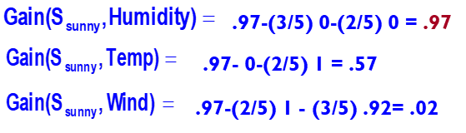
Information Gain Example

Slide 35
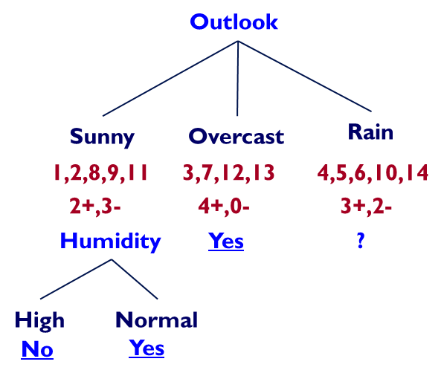
Information Gain Example

Slide 36
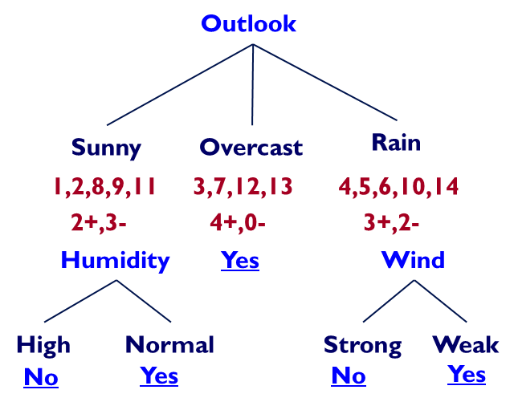
Information Gain Example

Slide 37
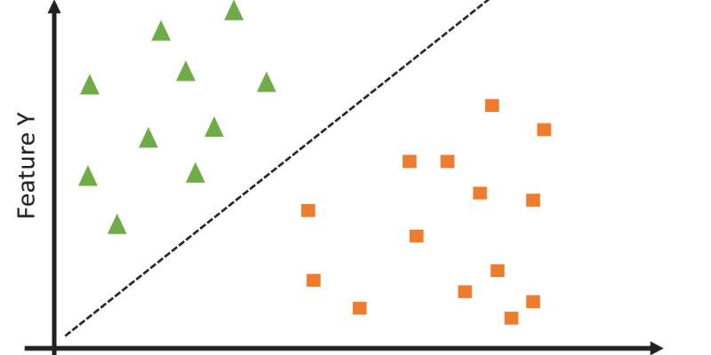
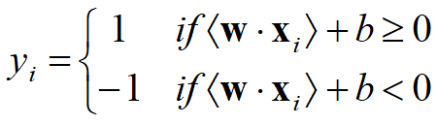
Support vector machines (SVM)
SVMs are linear classifiers that find a hyperplane to separate two class of data, positive and negative.
Kernel functions are used for nonlinear separation.
Let the set of training examples D be {(x1, y1), (x2, y2), …, (xr, yr)}, where xi = (x1, x2, …, xn) is an input vector and yi is its class label (output value), yi {1, -1} → 1: positive class and -1: negative class.
SVM finds a linear function of the form (w: weight vector)
f(x) = w x + b

Slide 38
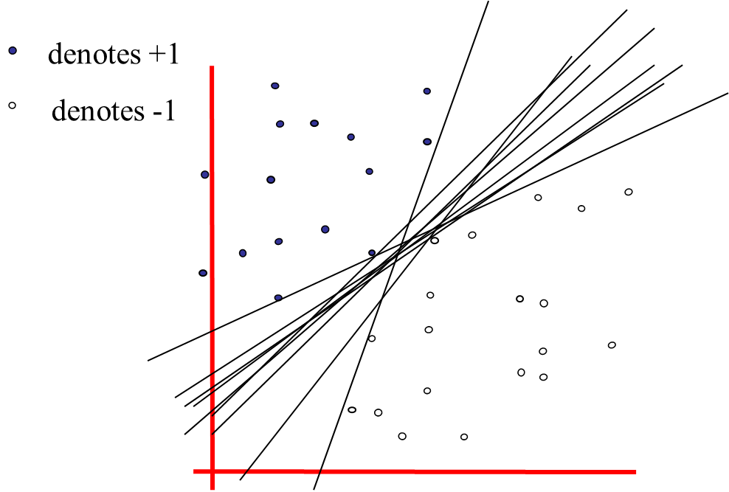
Hyperplane
So many possible hyperplanes, which one to choose?

Slide 39
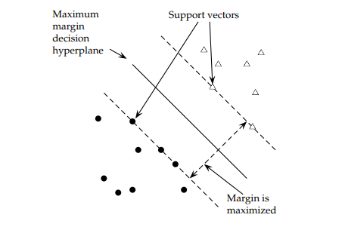
Maximal margin hyperplane
SVM looks for the separating hyperplane with the largest margin: this hyperplane minimizes the error bound
Support vectors are data points that are closer to the hyperplane and influence the position and orientation of the hyperplane.
Using these support vectors, we maximize the margin of the classifier.

Slide 40
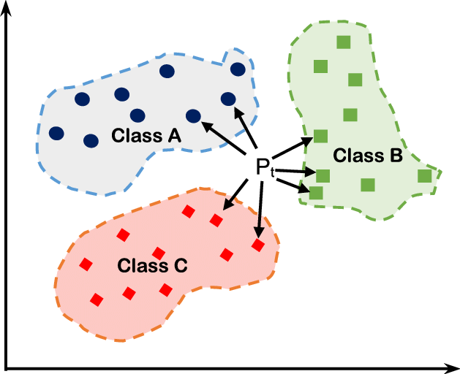
K-Nearest Neighbor (kNN) Classifier
KNN uses proximity to make classifications or predictions about the grouping of an individual data point.
For each record in the test dataset, kNN identifies k records in the training data that are the "nearest" in similarity, where k is an integer specified in advance
a class label is assigned on the basis of a majority vote, i.e. the label that is most frequently represented around a given data point is used

Slide 41
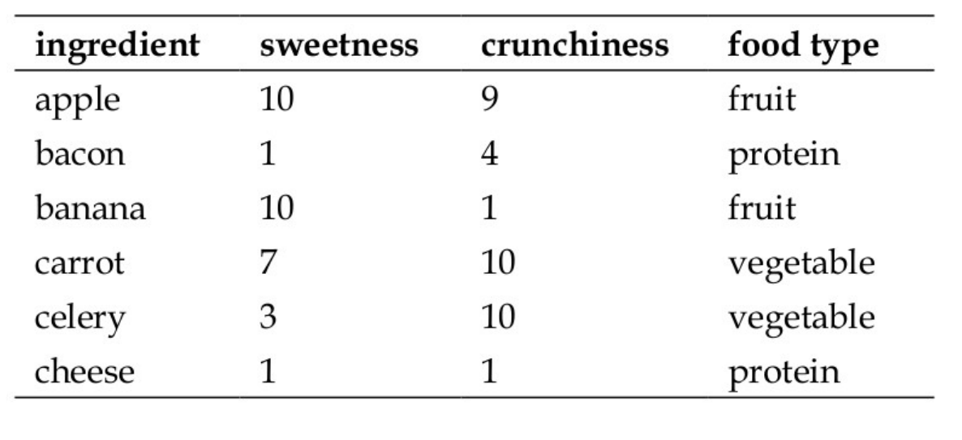
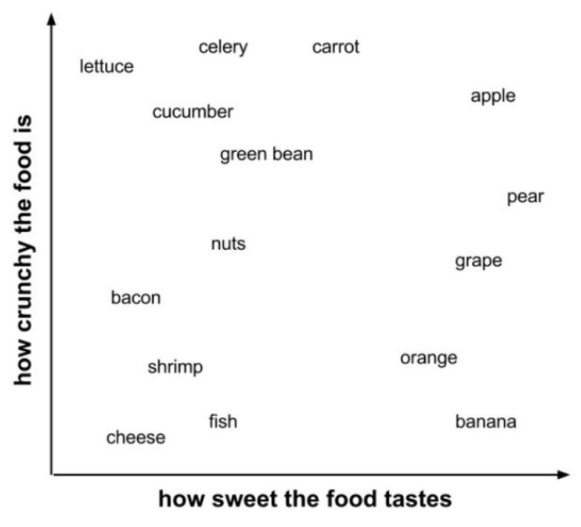
K-Nearest Neighbor (kNN) example

Slide 42
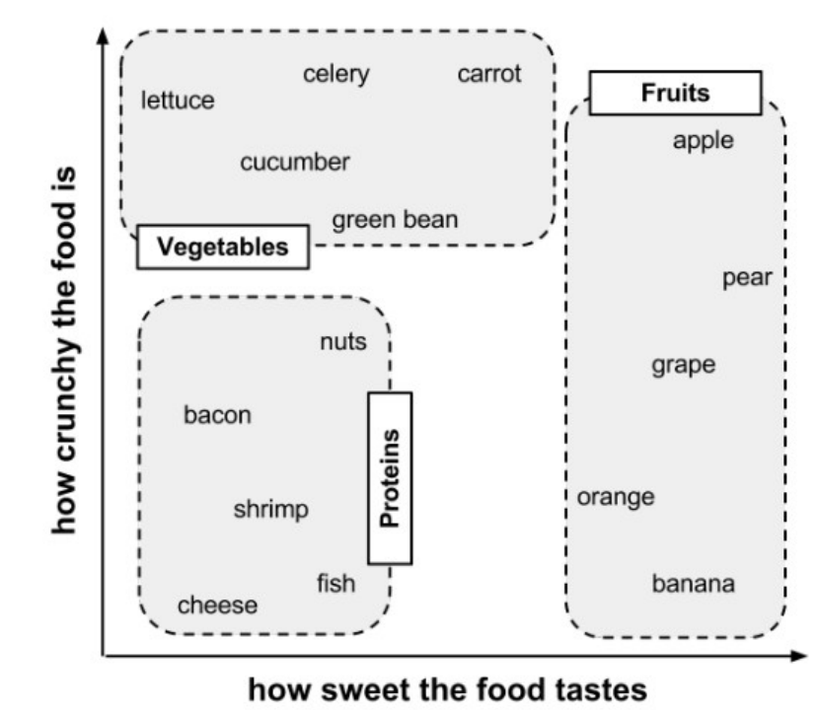
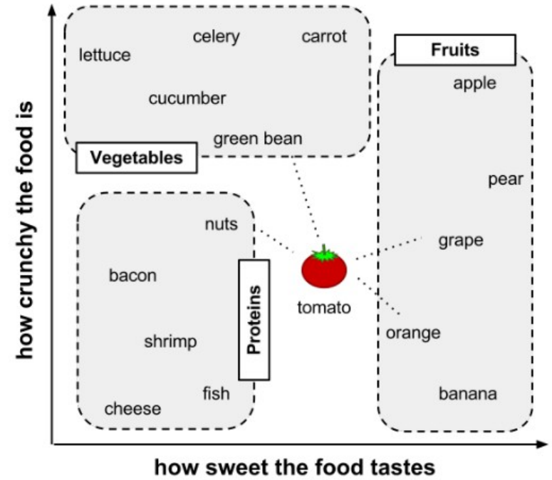
K-Nearest Neighbor (kNN) example
Which is the tomato’s class?

Slide 43
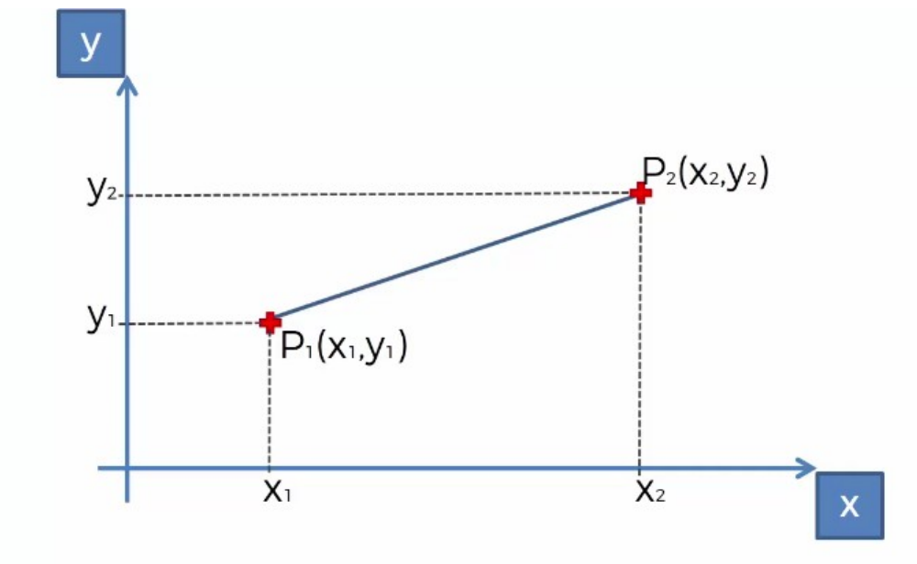
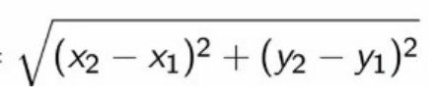
kNN: calculating distance
Locating the tomato's nearest neighbors requires a distance function, or a formula that measures the similarity between two instances.
Among the different ways to calculate distance, traditionally, the kNN algorithm uses Euclidean distance
Euclidean distance between P1 and P2 =

Slide 44
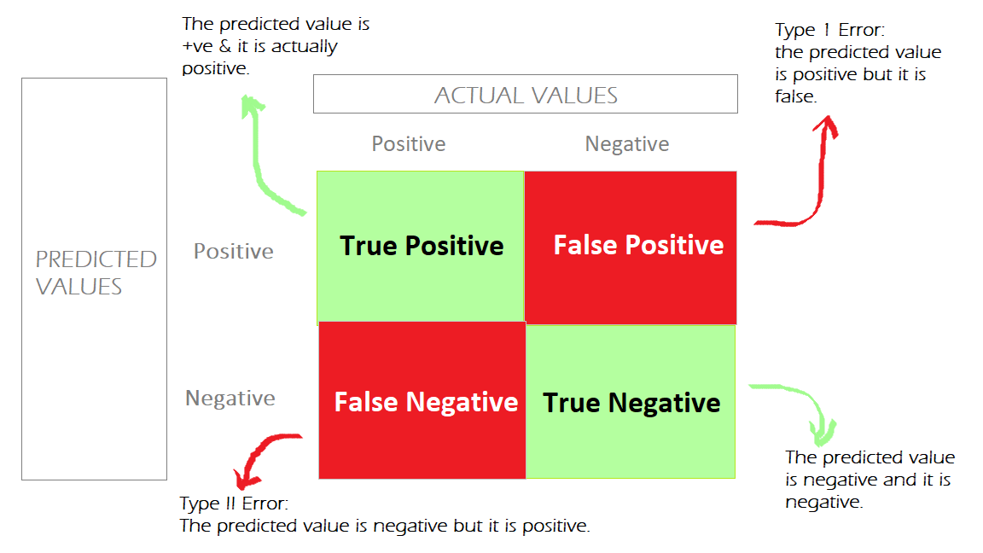
Evaluation Metrics: confusion matrix

Slide 45
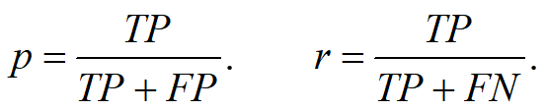
Evaluation Metrics: precision & recall
Precision p is the number of correctly classified positive examples divided by the total number of examples that are classified as positive.
Recall r is the number of correctly classified positive examples divided by the total number of actual positive examples in the test set.

Slide 46
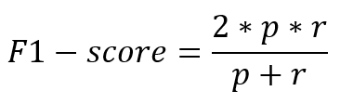
Evaluation Metrics: F1-score
F1 score combines precision and recall into one measure.
The harmonic mean of two numbers tends to be closer to the smaller of the two.
For F1-value to be large, both p and r must be large.

Slide 47
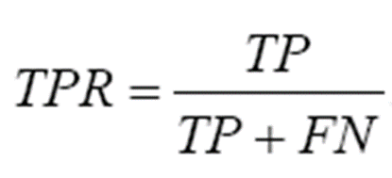
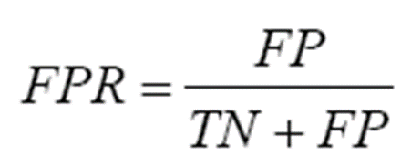
Evaluation Metrics: ROC
It is commonly called the Receive operating characteristics (ROC) curve.
It is a plot of the true positive rate (TPR) against the false positive rate (FPR).
True positive rate:
False positive rate:

Slide 48

Evaluation Metrics: ROC
The red line represents a random classifier, where the TPR equals FPR. Points above or to the left of this line indicate better classifiers, with the leftmost points showing the best probability thresholds.
The blue, orange, and green lines are ROC curves, with the blue line being the most efficient as it’s furthest from the random classifier.
A perfect classifier is represented by a blue dot at coordinate (0,1), where all positives are correctly classified and no negatives are incorrectly classified, meaning there are no incorrect predictions.

Slide 49

Ensembling
Different Classifiers: Each of the classifiers is not perfect
Conduct classification on a same set of class labels
May use different input or have different parameters
May produce different output for a certain example
Idea
Combine the classifiers to improve the performance
Ensembles of Classifiers
Combine the classification results from different classifiers to produce the final output
Unweighted voting
Weighted voting

Slide 50

Ensembling: example
image from: CS 4700, Foundations of Artificial Intelligence, Carla P. Gomes

Slide 51

Bias-Variance Tradeoff
Proper understanding of bias-variance would help us not only to build accurate models but also to avoid the mistake of overfitting and underfitting.
Bias is the difference between the average prediction of our model and the correct value which we are trying to predict. Model with high bias pays very little attention to the training data and oversimplifies the model.
Variance is the variability of model prediction for a given data point or a value which tells us spread of our data. Model with high variance pays a lot of attention to training data and does not generalize on the data which it hasn’t seen before.

Slide 52
Ensembling methods
Ensemble methods that minimize variance
Bagging
Random Forests
Ensemble methods that minimize bias
Functional Gradient Descent
Boosting
Ensemble Selection

Slide 53

Bagging
Bagging stands for bootstrap aggregation.
• It combines multiple learners in a way to reduce
the variance of estimates

Slide 54

Random Forest
The random forest algorithm
combines multiple algorithm of the same type i.e. multiple decision trees, resulting in a forest of trees, hence the name "Random Forest"
can be used for both regression and classification tasks.
Pick N random records from the dataset
Build a decision tree based on these N records
Choose the number of trees you want in your algorithm and repeat steps 1 and 2
The final value can be calculated by taking the average of all the values/selecting the majority value predicted by all the trees in forest.

Slide 55

Boosting
Boosting algorithms are a set of the low accurate classifier to create a highly accurate classifier.
Build a model from the training data
Create a second model that attempts to correct the errors from the first model
Models are added until the training set is predicted perfectly or a maximum number of models are added

Slide 56
Regression

Slide 57
Regression
Regression analysis attempts to determine the strength of the relationship between one dependent variable (usually denoted by Y) and a series of other changing variables (known as independent variables).
The two basic types of regression are:
linear regression that uses one independent variable to explain and/or predict the outcome of Y
Y = a + bX
multiple regression that uses two or more independent variables to predict the outcome
Y = a + b1X1 + b2X2 + … +bnXn
Y = the variable that we are trying to predict X = the variable that we are using to predict Y a = the intercept, b = the slope

Slide 58
When do we use linear regression?
Linear Regression can be used in different scenarios:
Sales Forecasting: Predicting future sales based on historical sales data.
Real Estate Pricing: Estimating the price of a house based on features like size, location, number of rooms, etc.
Stock Price Prediction: Predicting future stock prices based on past performance and other factors.
Risk Assessment: Assessing risk in financial services or insurance domains based on customer features.
Healthcare: Predicting disease progression based on patient data.

Slide 59

Simple Linear Regression
Simple linear regression predicts the value of a dependent variable based on an independent variable. The greater the linear relationship between the independent variable and the dependent variable, the more accurate is the prediction.

Slide 60

Simple Linear Regression
The task of simple linear regression is to exactly determine the straight line that fits the data points as closely as possible, minimizing the error or “residual” (ϵ)
The residual represents the distance between the estimated and true values.
The method used to minimize the sum of the squared residuals and determine the regression coefficients (a and b) is called Ordinary Least Squares (OLS).

Slide 61

Machine Learning in Sport Analytics
Player Tracking and Movement Analysis: it can be used for player tracking and movement analysis. Technologies like GPS and accelerometers generate data capturing every athlete’s movement. This data is analyzed to provide insights like speed, distance traveled, and real-time positioning. In football, this helps teams analyze opponents’ movements and strategize. In basketball, for example, it aids in optimizing player positioning and tactical decision-making.

Slide 62


Machine Learning in Sport Analytics
Injury Prediction and Prevention: By analyzing historical data, training routines, and biometrics, Machine Learning approach can spot early injury indicators. Sports organizations can use this to adjust training, rest schedules, and strategies, reducing injury likelihood. This maintains player well-being, allowing longer game participation and enhancing team success.

Slide 63

Machine Learning in Sport Analytics
Performance Optimization: Machine Learning optimizes athlete performance by analyzing past performances and identifying strengths, weaknesses, and areas for improvement. This is particularly valuable in individual sports like, e.g., tennis, athletics. Machine Learning can also develop customized training programs tailored to athletes’ needs, optimizing training efficiency, accelerating skill development, and improving performance.

Slide 64

Machine Learning in Sport Analytics
Game Strategy and Playbook Design: Machine Learning can analyze large volumes of historical match data to identify player and team patterns. This analysis aids coaches in formulating efficient strategies and playbooks to counter specific opponents. By understanding the opposing team’s strengths and weaknesses, strategies can be developed to exploit these vulnerabilities. This data-driven approach gives teams a competitive edge and increases their chances of success.

Slide 65

Machine Learning in Sport Analytics
Recruitment and Talent Scouting: Machine Learning can help sports teams identify talented young athletes with high potential. It examines various attributes, including performance stats, physical traits, and mental characteristics, to predict future achievements. ML enhances talent scouting efficiency by analyzing large talent pools and identifying potential candidates based on objective data. This minimizes the risk of overlooking exceptional talent, ensuring a competitive team roster.

Slide 66
Reference & useful links
https://www.cs.cmu.edu/~tom/mlbook.html
https://medium.com/mlearning-ai/underfitting-and-overfitting-in-deep-learning-687b1b7eb738
https://medium.com/dataduniya/machine-learning-in-sports-analytics-and-performance-prediction-d7f50799f684
Moller, Web-Mining Agents: Classification with Ensemble Methods
G. Howard, “Classification Basic Concepts Decision Trees Evaluation Nearest-Neighbor Classifier”
https://medium.com/@brijesh_soni/understanding-boosting-in-machine-learning-a-comprehensive-guide-bdeaa1167a6
https://medium.com/@sarah.ahmed.aboelseoud/beyond-the-numbers-understanding-linear-regression-modeling-2c9ae5697199
https://medium.com/@u.victoramanze345/evaluate-simple-linear-regression-cf9bdc1f3c54
CS 446, Machine Learning Fall 16
https://machinelr.blogspot.com/2016/08/knn-classification.html
https://medium.com/@nikitamalviya/confusion-matrix-870739a1ec31
https://sefiks.com/2020/12/10/a-gentle-introduction-to-roc-curve-and-auc/

